Slide 1


Speak English Professionally: In Person, Online & On the Phone

Slide 2
Agile Leadership
Our Motto -
“Delivering Value through People,Passionate learning and Innovation”

Slide 3
01
This course explores speaking english professionally, in-person, online and on the phone.
Course Overview
02
The core objective of this course is work on professional conversational vocabulary and proper delivery of an elevator pitch.
Course Objective
03
Upon completion of this course, decadevs are expected to:
Understand the importance of face-to-face communication
Prepare an elevator speech with ease
Be able to engage in small talk
Execute better video conferencing etiquette
Learning Outcome
04
Workshop/Discussion method
Teaching Approach
05
The assessment for this course is attached to the last slide of this deck.
Assessment

Slide 4

FACE-TO-FACE COMMUNICATION
Face-to-face communication is having the ability to see the other person or people physically during a conversation. It is an opportunity for the people having the conversation to exchange more than words and have a deeper more meaningful conversation.
Face-to-face communication can also be referred to as interpersonal relationships.
It is the standard communication method and the most complex and complete method that all the other forms of communication try to imitate.
Face-to-face communication creates our relationships in real time. And this makes face to face communication perfect for complex tasks that require a one-on-one session.

Slide 5

COMPLEX TASKS
Co-creation : This includes activities such as the Managed Internship Projects.
Building relationships : This solidifies, seals, and legitimizes work relationships and shared experiences and shared meanings are created during conversations.
Collaborative problem solving: Bouncing ideas back and forth and communication is sustained properly because communication happens face to face.

Slide 6

ELEVATOR PITCH
An elevator pitch is a concise and compelling summary, typically lasting no longer than a brief elevator ride, designed to quickly and effectively communicate a person's or business's value, proposition or idea.
Whatever industry a person works in you’re always selling yourself, whether in a job interview, selling your products or selling your ideas and persuading other people to see things in your perspective.

Slide 7

STEPS TO THE PERFECT ELEVATOR SPEECH
STEP 1: When starting an elevator pitch it is very important to be able to learn to pitch your product, service or idea in one sentence. This is used to know who you are, what you do, and how you bring value.
Sample: I help X achieve Y by doing Z.
X= Audience (people you want to reach out to)
Y= The value that you bring
Z= How exactly do you provide that value.
STEP 2: The next step is to tell a story because its more engaging. Using a story helps your audience to understand a complex idea when it is broken down to more relatable occurrences. The story needs to be included in the pitch and the first thing you want to talk about in the story is the problem that was discovered.

Slide 8

STEPS TO THE PERFECT ELEVATOR PITCH
STEP 3: Explain a solution or what you did to assist the client in the story who was in need.
STEP 4: Value (why was your work for that client valuable). Then explain to your prospective client exactly how you can help them.
Crafting the perfect elevator pitch is a crucial skill that can significantly impact your ability to make a memorable and impactful impression in a short amount of time.
Remember, the key is not just to convey information but to spark interest and leave a lasting impression.

Slide 9
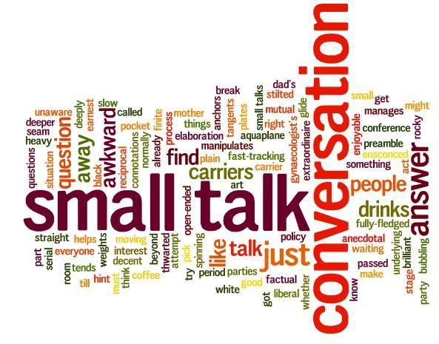

SMALL TALK
Small talk is a cornerstone for building rapport in your professional space.
It is the pathway to learning something new about your coworker, finding a meaningful connection, and discovering a potential new friendship.
Small talk plays a large role in rapport development since it's the basis for verbal communication between two people.
Asking the right questions, with the right level of interest and at the right time is a good way to lay the foundation for a positive relationship with another person.
3 STRATEGIES FOR SMALL TALK
Strategy 1: Start with a compliment and then ask a connected question.
Strategy 2: Get the conversation going with engaging questions.
Strategy 3: Ask for advice or ask for an opinion.

Slide 10

VIDEO CONFRENCE ETTIQUETE
Navigating Video Conferencing: Common mistakes to avoid.
Bad Connection: Make sure your connection is strong enough to carry you through the period of your meeting.
Angle: Avoid placing your device in awkward angles. Always make sure your camera is placed at your eye level.
Lighting: Test your lighting in advance of your meeting to ensure the video feed is not blurry or casting shadows.
Muffled sound: Your sound is very important in every meeting. Always check that your microphone is working properly.
Pets: Avoid pets around you during meetings, close your door.
Distractions: Get rid of every form of distraction before your meeting starts.
Don’t Overdress or Underdress

Slide 11
CLASS ACTIVITY
CONTEXT
You have been scheduled for an interview with a fintech called Octagon as the lead developer and you must pitch yourself as accurately as possible during the interview to begin work the following week.
Create the perfect elevator speech which will communicate who you are, what you're looking for and how you can benefit Octagon.
Instructions
The class activity will be done individually.
10 mins to brainstorm the perfect elevator speech.
The write-up should be submitted in a word document.
The activity will be presented in 40 seconds.

